Slide 1
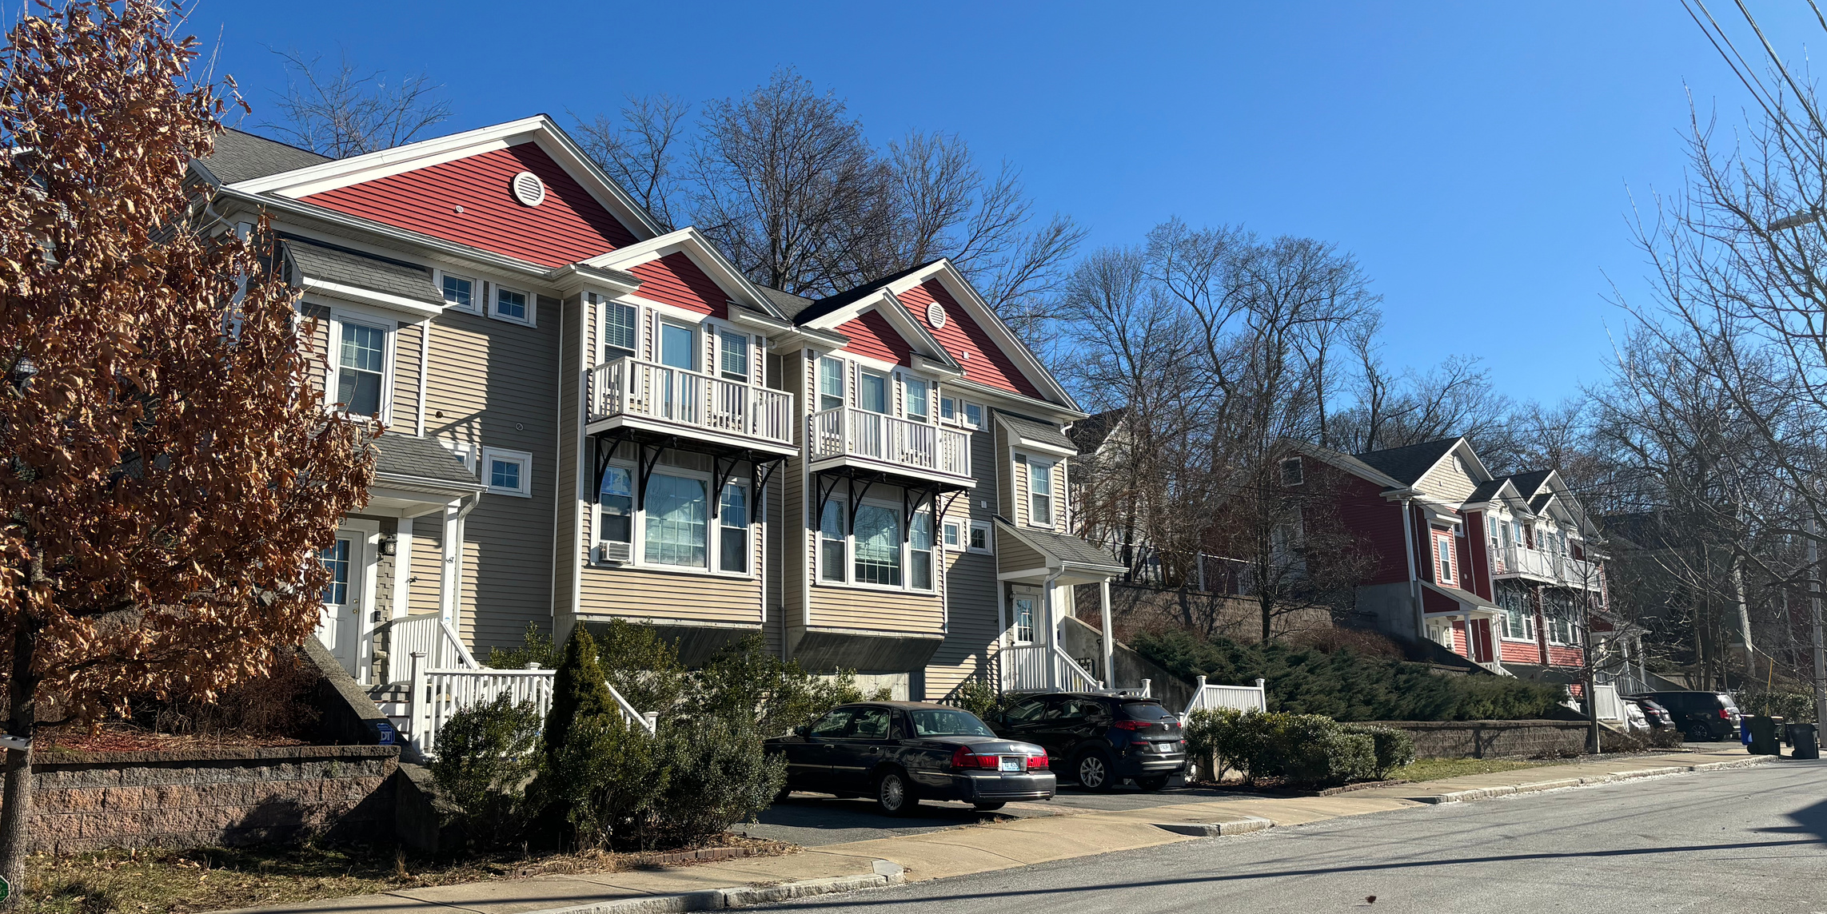

COMMUNITY HOUSING LAND TRUST OF RI
Presented by: Melina Lodge, Executive Director
www.housingnetworkri.org/our-work-programs/
community-housing-land-trust-of-rhode-island

Slide 2
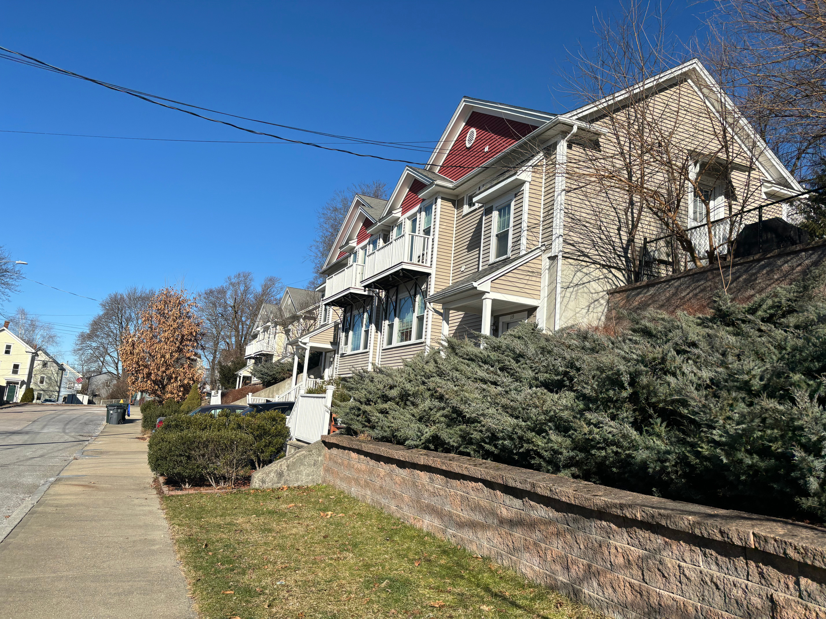
ABOUT
CHLT RI
The Community Housing Land Trust of Rhode Island (CHLT) is a non-profit affiliated with the Housing Network of Rhode Island with a mission to expand and maintain the supply of long-term affordable housing available for generations of Rhode Islanders through the provision of high quality monitoring services and technical assistance. CHLT partners with developers and municipalities throughout the state to develop affordable homes, utilizing various forms of public subsidy. Post construction, CHLT works with homeowners, tenants, rental property owners and property managers to support and maintain ongoing compliance for the duration of the deed-restricted period.
www.housingnetworkri.org/our-work-programs/
community-housing-land-trust-of-rhode-island

Slide 3
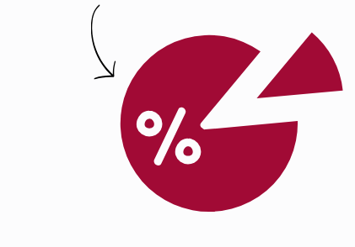
Sample Scenario
Page 02
Developer A builds and sells a 2-bedroom, 120% AMI deed-restricted condo located in East Greenwich, Rhode Island.
The monthly condo fee is set at $200.
Based on 2025 income limits for a household of three people (number of bedrooms plus one person), we would use $123,480 annual income as the basis for our resale price calculation
From there, we establish what the maximum monthly housing costs would need to be in order to be affordable (30%) at this level of income, which equals $3,087 per month. This is the “whole pie.”
Maximum monthly housing costs: $3,087

Slide 4

Now, we start to carve out pieces of the pie
Resulting maximum
purchase price:
$336,576
Mary Smith purchases the home for $336,576 and lives there very happily for five years.

Slide 5
Now, let’s fast forward. Mary has decided to retire to Florida, and wishes to sell her affordable home in Rhode Island.
For the purpose of this exercise, we will assume income, condo content insurance & interest rates has remained the same – but condo fees have risen to $500. PMI, taxes and PITI will change as part of the price calculation. The “whole pie” is still $3,097, but now divides up as follows:
Resulting maximum
sales price:
$301,234

Slide 6

While Mary Smith purchased her home for $336,576 now due to increases in the condo fees, the maximum sales price for Mary’s home 5 years later would only be $301,234.
Page 02
Please note that this scenario is meant to illustrate the how rising condo fees can impact pricing and is not reflective of an actual transaction where a homebuyer lost over $35,000 in real value.

